Slide 1

StudySpace
By Prathmesh Bhatt and Priyanka Ganesan

Slide 2
Background/ Problem
Finding study spots on campus takes and average of 15-20 minutes.
Accommodating
Group Study
Finding the closest study spot
Availability of outlets, and Whiteboards
Finding a spot that is caters to the students study needs.
There is currently no streamlines solution to help find study spots in a time efficient manner.

Slide 3
Solution
An app which makes hunting for places to study on campus obsolete.
Using the QR codes which will be provided on each table at any University.
students can book the study spot. Be it a meeting room, or even a small table, studySpace got you covered.
Just search for a place in our database containing all the spots to study on the UTD campus, check for the required amenities such as plug points, White boards and accessibility friendly etc, reserve the spot!

Slide 4
Tech Stack
Front end : React Native
Backend : Firebase, Node js
API’s : Google Maps API, Scanner API, Universities and Colleges API
Python for data analytics - We can also collect data such frequency of use of space for the University to implement better seating arrangements and accommodations etc.

Slide 5
Future Features
Allow students to choose if they would like to share their study space.
Integrate with university apps
Students can pick noise levels and recommendations with be provided accordingly
Campus map can be integrated to help students navigate to their location

Slide 6
Limitations to our solution
It is going to require adaptation to a new normalcy on campus to effectively implement.
There is a long preparation process for the university prior to offering service to students

Slide 7
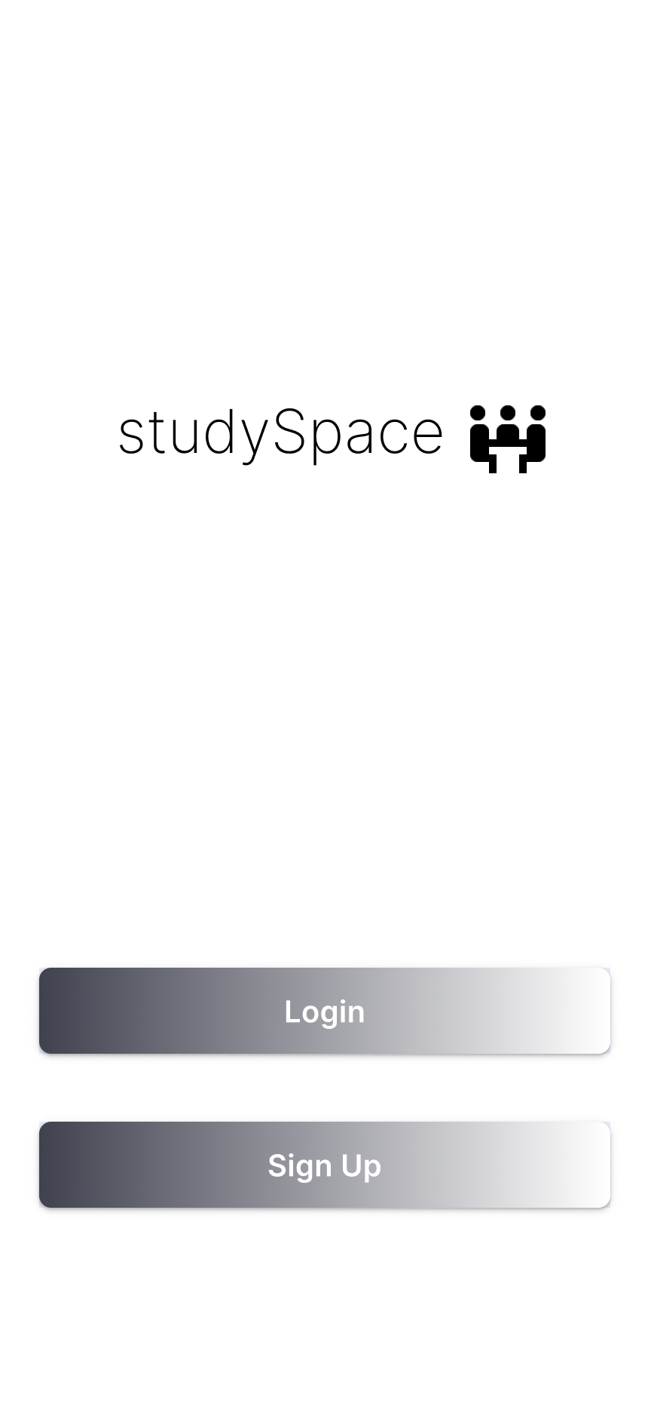
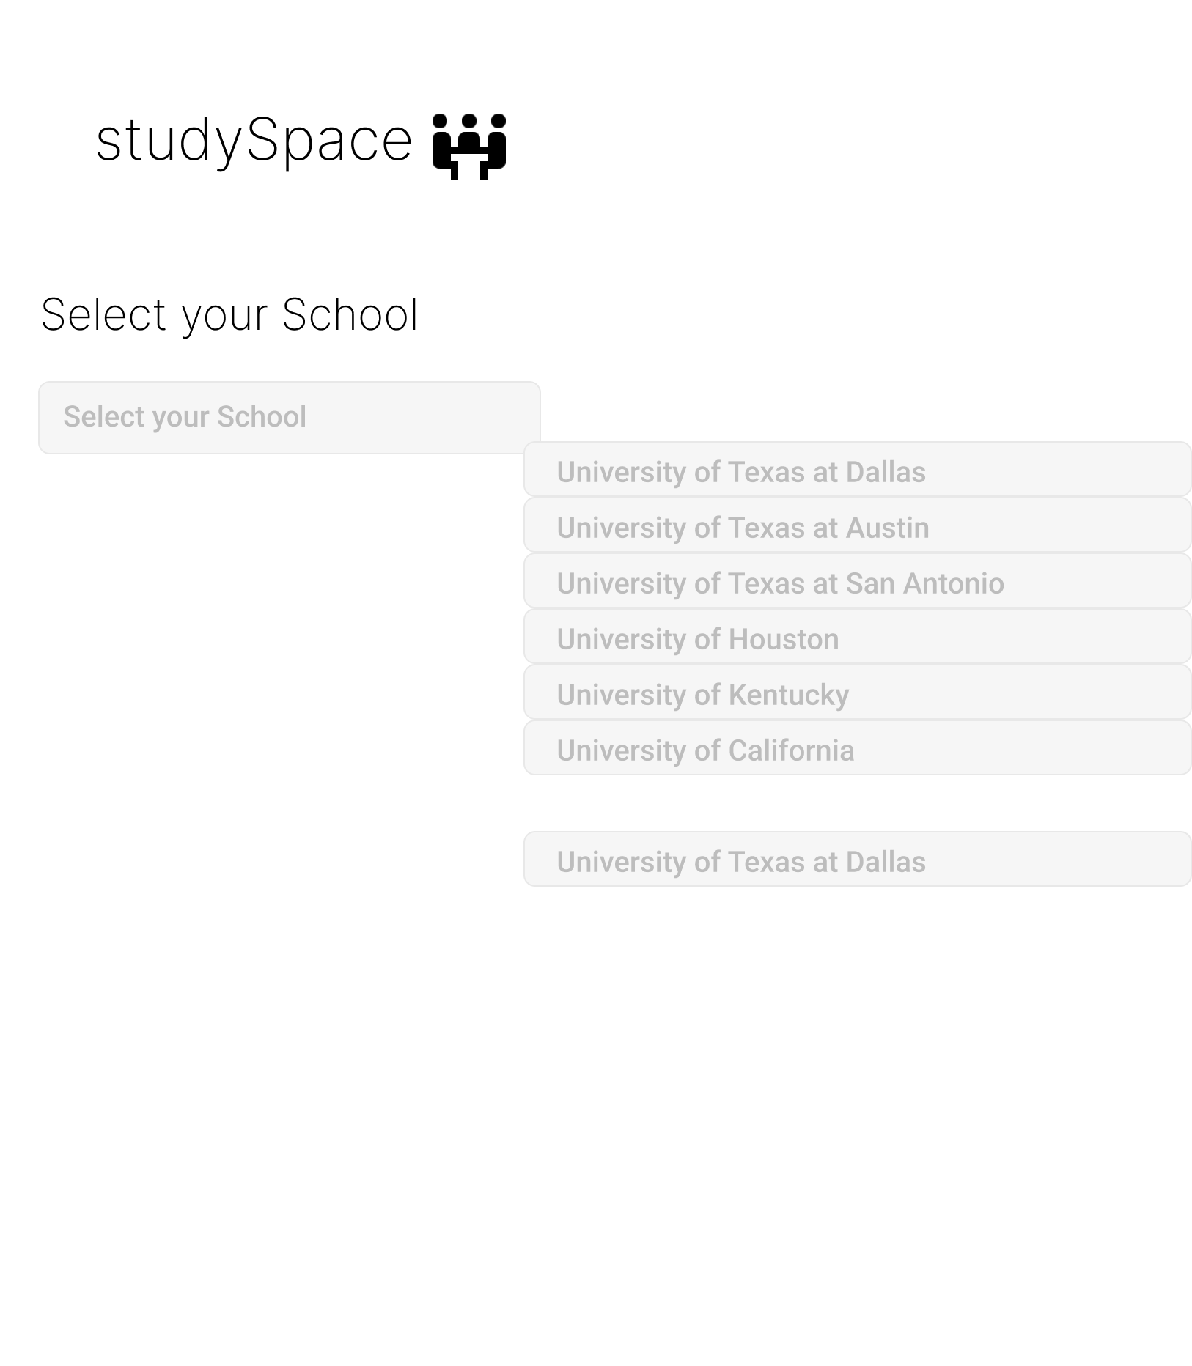
Login and Register

Slide 8
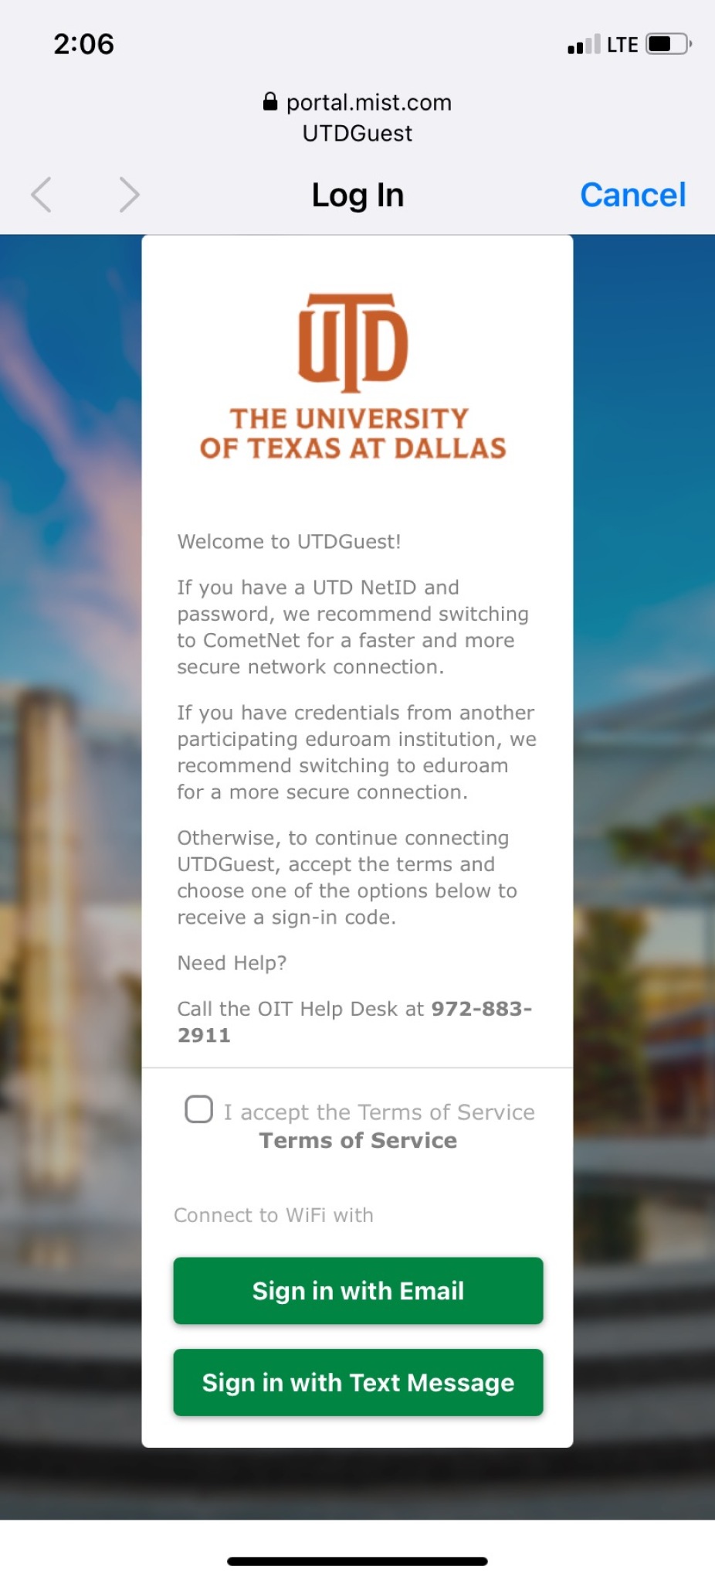
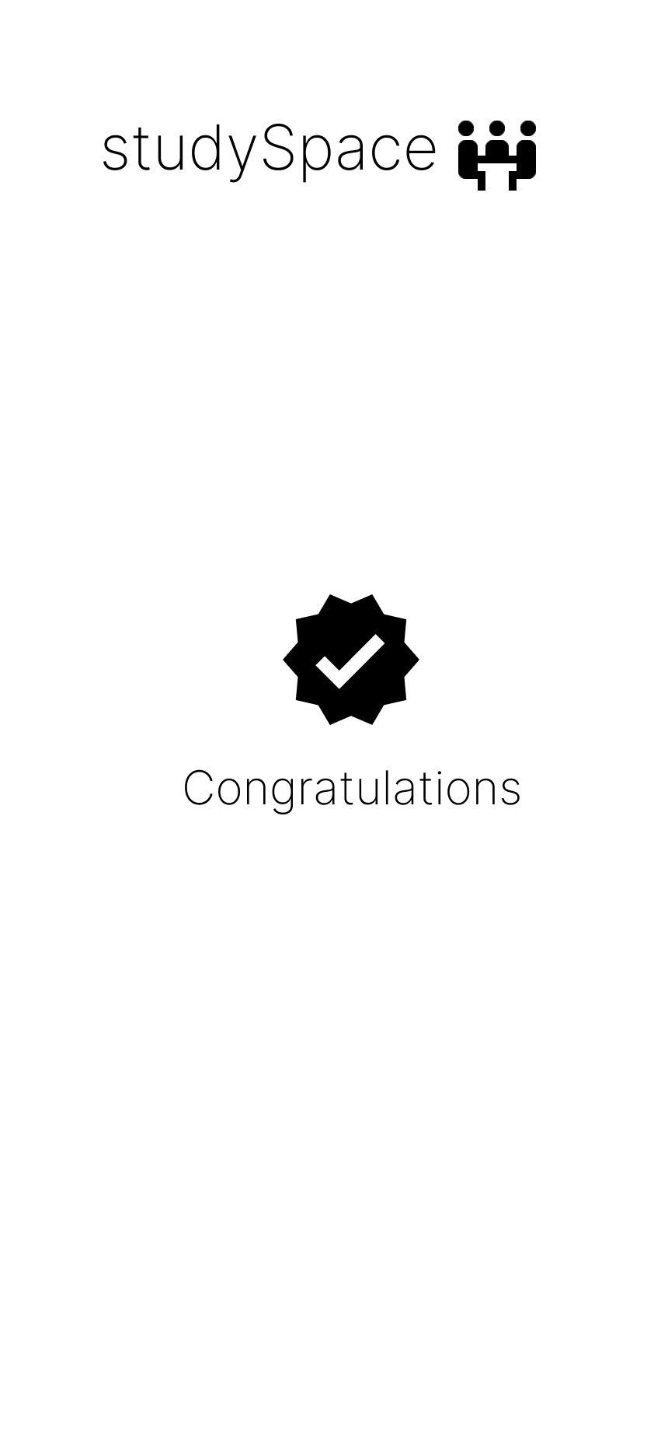

Slide 9
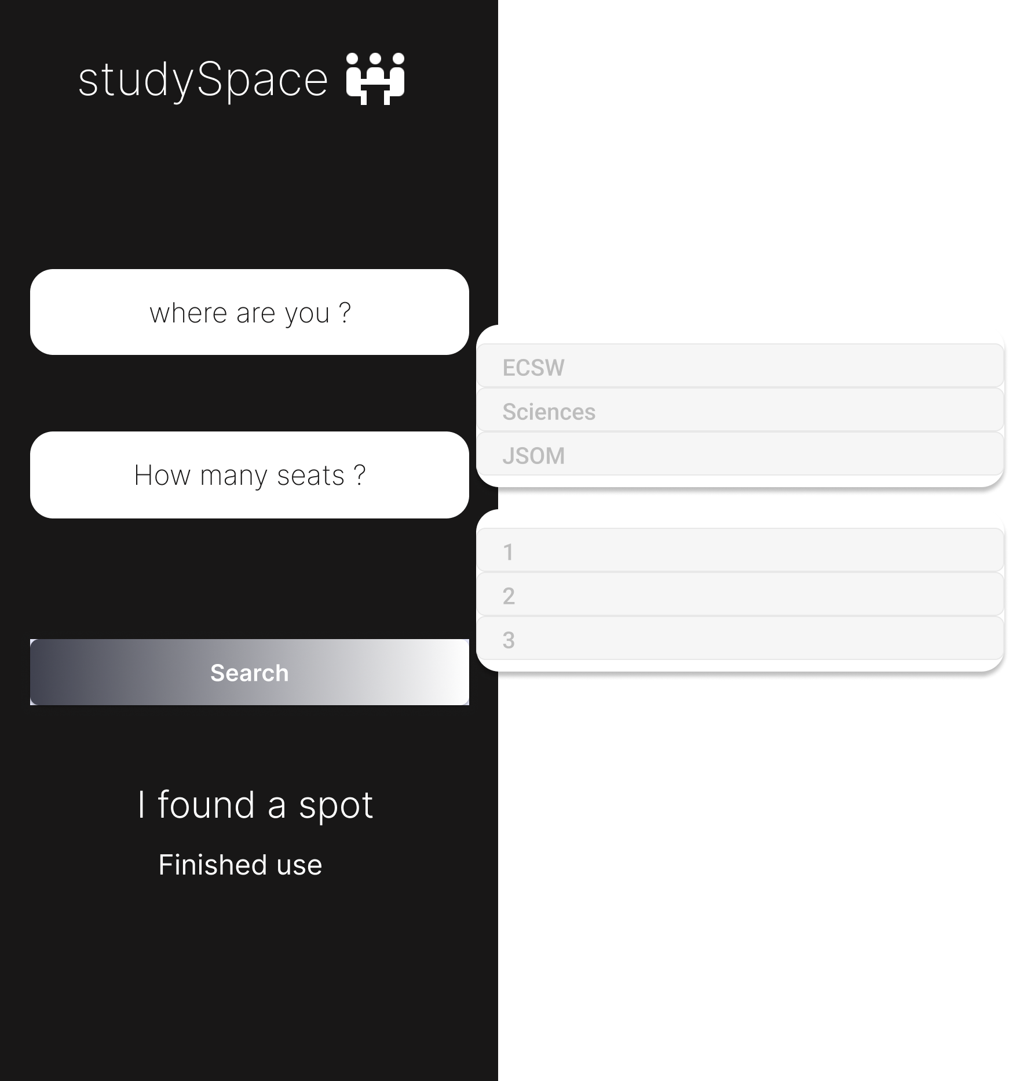
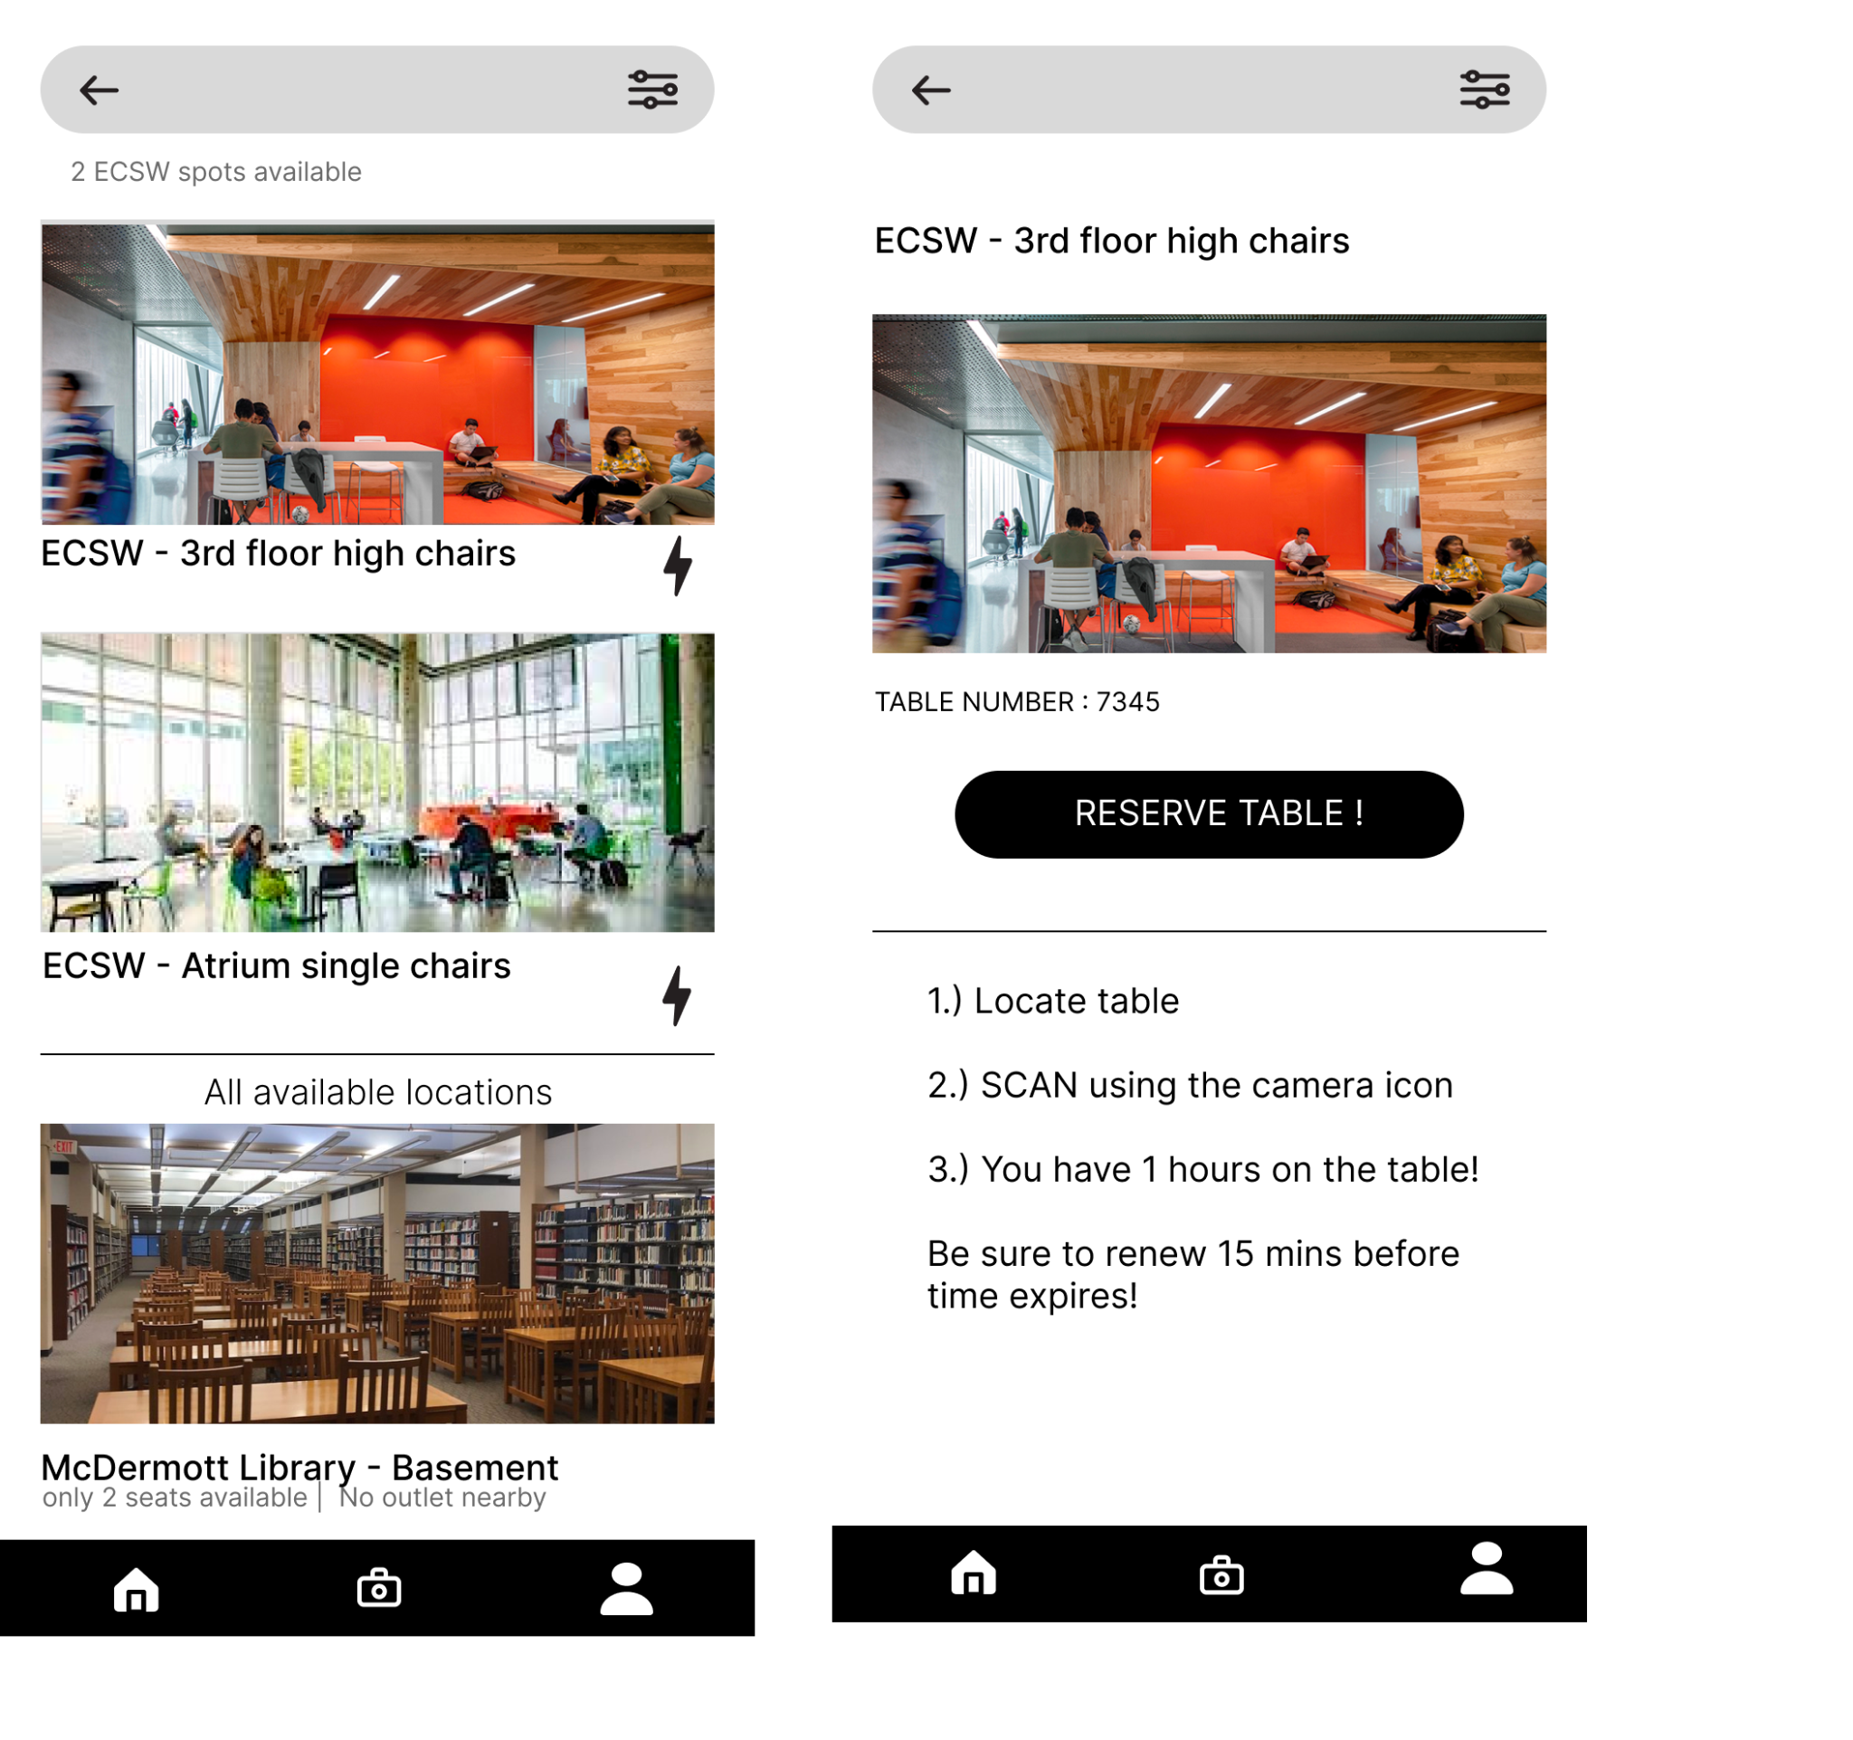
Reservation

Slide 10
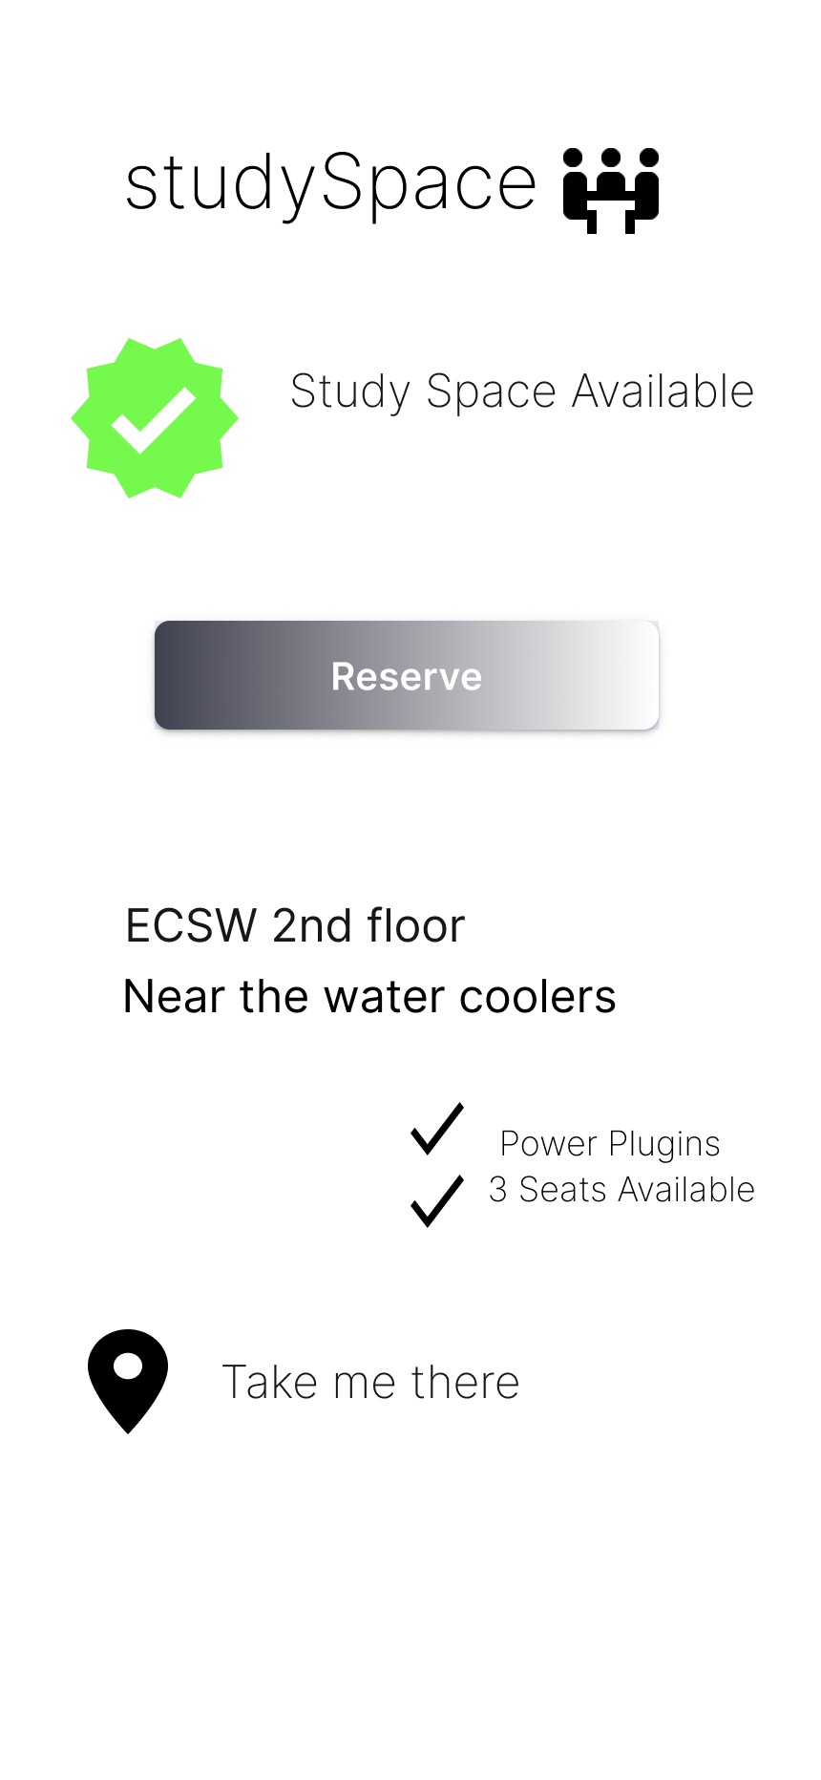
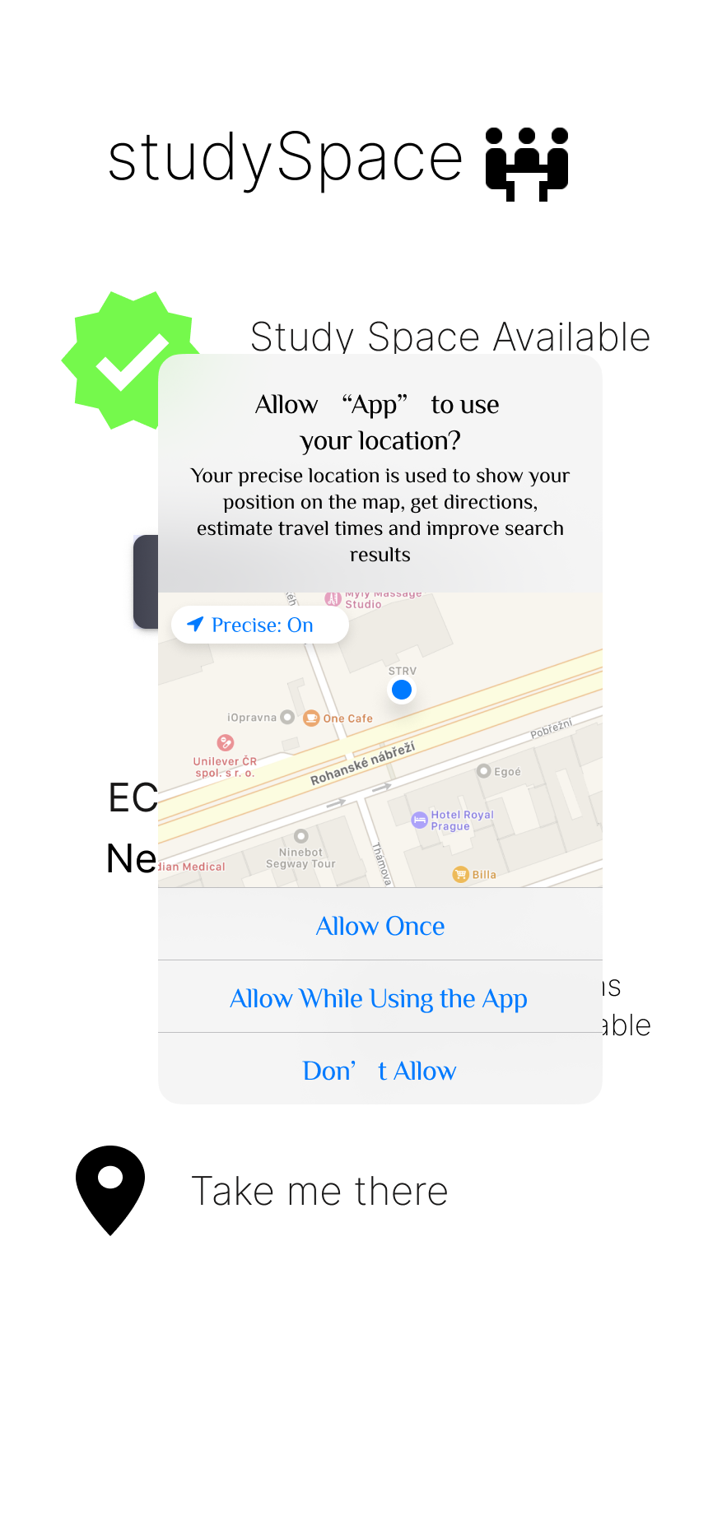

Scanner and Checking reservations

Slide 11

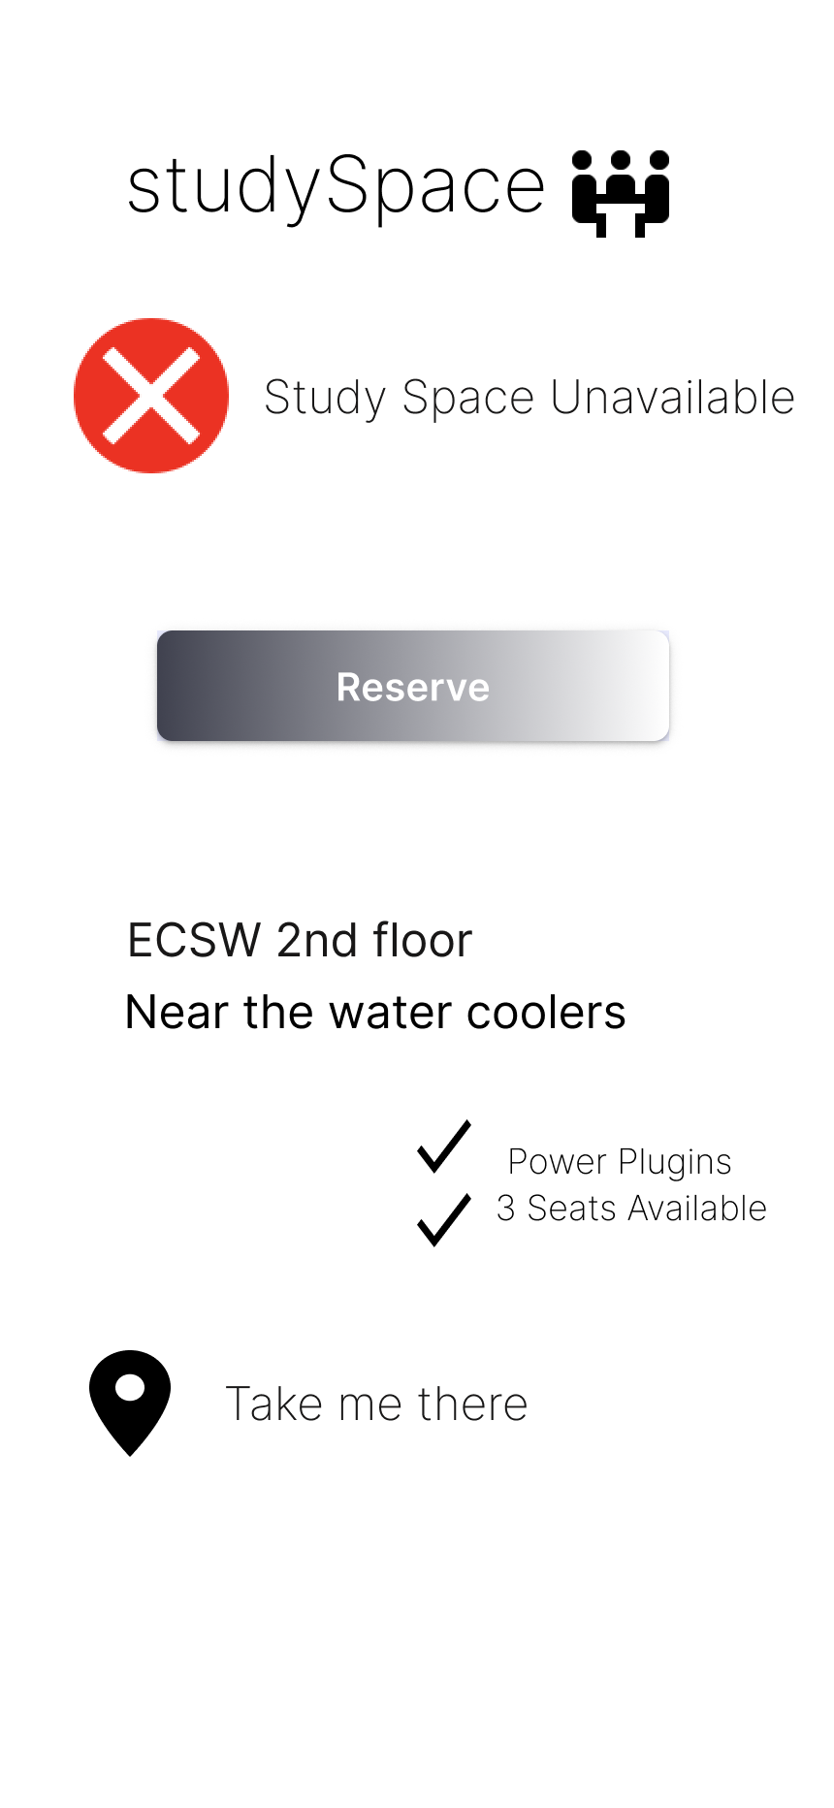

Slide 12
We greatly appreciate your time!
Thank You!

